Slide 1
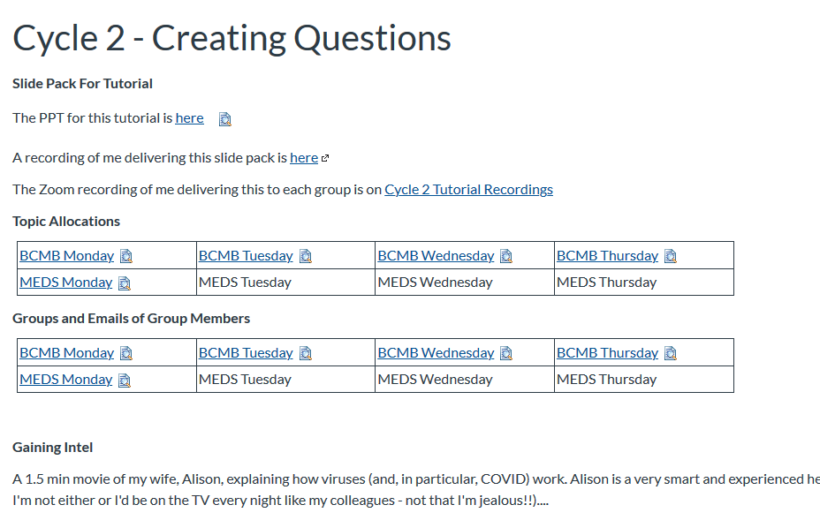
PeerWise Cycle 2
This is the Canvas page that has everything you need
You should have watched the recording before this tute, but it doesn’t matter too much if you haven’t
We start for real at 1:05 pm

Slide 2
Overview
Allocated to groups of ~6 students
Each group is given a topic – list on Canvas
Before Cycle 3 (fortnight from now) each student makes an MCQ
Immediately: Discussion with Peers – gaining intel, confessing, explaining
By Day 6: Submit Draft MCQ
By Day 12: Complete commenting – feedback and suggestion
By a fortnight from now: Final MCQ revised
Another low stakes mark….
Just training for later…
How to get intel, going through the creation and revision process

Slide 3
Group Allocations and Intel Gathering
Groups provided with each others’ emails
Up to you if, and how, you get together to exchange ideas
In an in-person tutorial I’d get the table to
Draw pictures, explain ideas to each other, ask questions
See Alison explaining viruses as an example!
Instinctive is BEST… don’t look at the textbook/slides
All of this gives brilliant intel
Substitutes
You’ll have your favourites….
Padlet, Zoom chat, email, etc, anything that involves Show & Tell
Assemble a list of insights/misconceptions and divvy them up

Slide 4
Activity #1: Confessions and Insights!
Each table has been allocated a specific topic
Contribute your thoughts on this topic
Be INSTINCITIVE
Being incorrect is as good as being insightful
And both are better than just being correct
Don’t look at the textbook or lecture slides
Explore any aspect, even tangential
If the very basics confuse, someone could go down that path

Slide 5
Activity #1: Gaining Intel
Write down as many statements about this as you can think of
Does not matter if they are right/wrong
Instinctive is best
Listen to someone explaining the topic
Or describing a diagram
Try out T/F statements on your peers
Listen to them going through the reasoning process
This is surprisingly effective

Slide 6
Activity #2: Draft your MCQ
First share the intel across your group
Good idea to store the intel in your eNotebook
Make a new folder/page somewhere
Even just a link to a Padlet, etc
Remember the eNotebook is YOUR legacy
Decide what direction each person could take

Slide 7
Exploring the Topic: Thinking Creatively
What were the stumbling blocks in peoples’ explanations?
What insights got you through? Light-bulb moments?
How much worse could it have got?
Does anything strike you as strange or noteworthy?
What didn’t you understand about this?
What don’t your peers understand about this?
What would happen if a step was inhibited/activated
What would happen if a component was in excess/short supply?
Can you think of an analogy for this?
Can you build a scenario or context around this?

Slide 8
MCQ Style
Your analysis of the seven presented in Cycle 1 Tutorial was great
You already have a keen sense for what makes a good/bad MCQ
But now I’ll tell you my preferences…

Slide 9
Common Errors
In addition to the ones you spotted in Cycle 1
Too many negatives
Explaining too much in the stem – too much background.
Get to the point ASAP
Options with multiple concepts

Slide 10
One Concept in Stem and Each Option
THIS IS TERRIBLE FOR SO MANY REASONS
Which of the following statements A-E is FALSE? Difluoromethylornithine (DFMO) is a general inhibitor of ornithine decarboxylases (ODCs); it is anti-trypanosomal but innocuous to the mammalian host because:
trypanothione which is derived from the ODC product acts as glutathione does in mammalian cells to maintain sulfhydryl groups in their correct oxidation states
although human ODC is a key enzyme for the biosynthesis of polyamines it is subject to the action of antizyme and has a short half life
it binds more tightly to the trypanosomal enzyme than to the human enzyme
for at least in the case of T. b. gambiense, the enzyme has a longer half-life than the human counterpart.
with an estimated in vivo half-life of about 20 minutes, upon one dose of DFMO, the irreversibly inhibited mammalian ODC protein will be degraded steadily at a high rate and replaced with active enzyme

Slide 11
Not a fan of the combination lock
On the walk from Redfern Station to Uni you will see: (i) A ginger cat (ii) Coffee shops (iii) A Thai restaurant (iv) Tropical fish shop. And in which order do you see them in…
(i) then (iii) only
(i) then (ii) then (iii)
(iii) then (iv) only
(i), (ii) and (iii) all together

Slide 12
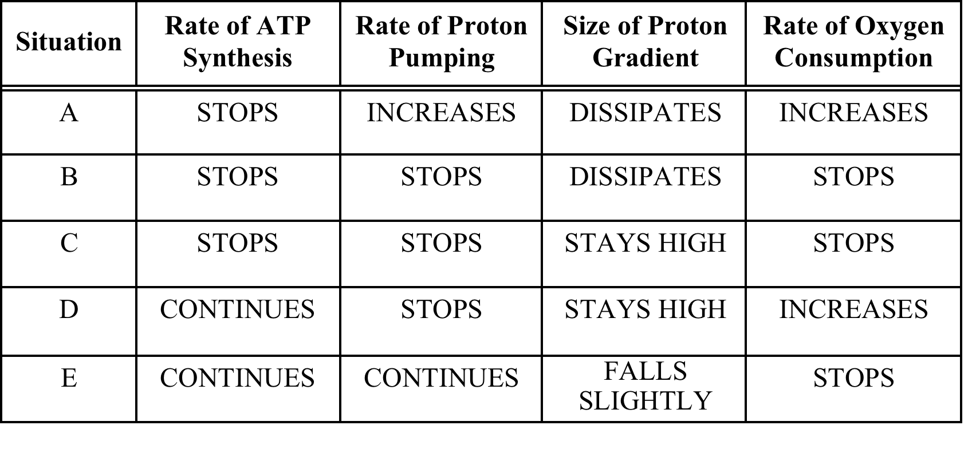
Although I do like this
Because the set up can be used to service many questions
An uncoupler
A lack of oxygen.
3. Exposure to an excess of a compound that accepts electrons half way down the electron transport chain.
4. An inhibitor of proton movement through the ATP-synthase.
Rotenone - which prevents the transfer of H/e- from NADH to the start of the electron transport chain.
Cyanide – which inhibits the transfer of electrons from the end of the ET chain to oxygen
A combination of (3) and (6)
The feral animal ‘fox bait’ 1080 which inhibits the Krebs Cycle

Slide 13
Breaking a process up into component parts and players gives many ideas
RATE ATP USAGE
WORK
ATP
ADP
RATE ADP ENTRY
H⁺
RATE ATP SYNTH
ATP
ADP
RATE H+ ENTRY
RATE FUEL CONS
Fuels
H⁺
RATE NAD/NADH TURNOVER
RATE METABOLIC PATHWAYS
NAD
NADH
RATE ELECTRON TRANSPORT
CO₂
H⁺
H⁺
RATE CO₂ PROD
H₂O
H/e
H/e
O₂
RATE O₂ USE
RATE PUMPING
H⁺
H⁺
SIZE GRADIENT

Slide 14
I like a graph or picture to interpret
Such stimulus material is best used for several questions
There are two inherited defects in galactose metabolism:
Gdef - a deficiency in galactokinase
Edef - a deficiency in UDP-glucose 4-epimerase.
These conditions can be identified by giving a galactose tolerance test – an intravenous infusion of galactose. The results of some of these tests are shown in the diagram
44. Which result (A – E) would you expect to see in a person with Gdef
45. Which result (A – E) would you expect to see in a person with Edef
46. How would you expect a Gdef patient to respond to consumption of lactose?
A. Blood lactate concentration rises
B. Liver enzymes appear in the blood stream
C. Blood uric acid concentration rises
D. A rise in blood galactose levels
E. They would become hypoglycemic
47. What characteristics would you expect an Edef patient to show.
A. Inability to make liver glycogen
B. Even a short period of starvation makes them hypogylcemic
C. Inability to absorb galactose from the gut
D. Lactose consumption makes liver enzymes appear in the blood
E. Excessive gas production after consuming lactose

Slide 15
Simple Extrapolation
A defect in muscle glycogen phosphorylase (GP) would have which consequence?
Muscles could not use glucose as a fuel
Muscles could not produce lactic acid
You could walk but not sprint
During exercise, muscles would be wholly reliant on fatty acids
It will not be possible to maintain blood glucose above 4 mM during starvation
Note the flexibility - muscle GP could be replaced by glucose transporters, liver GP, PDH, etc
Although note that much of the time these things are conjecture!

Slide 16
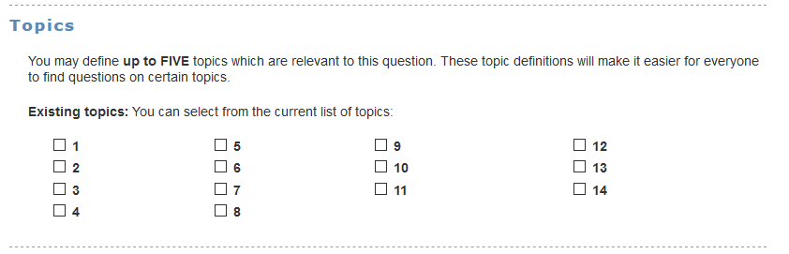
ACTIVITY #3: Add MCQ to PeerWise
Identifier is your Unikey
To specific course for your Day
Tag it appropriately
Your group Number
Tags are under TOPICS in Peerwise
This time there is a mark penalty
Only use ONE tag please
By midnight six days from now
 | Course IDs
Day | BCMB (Week 5) | MEDS (Week 6)
Mon | 21140 | 21144
Tue | 21141 | 21145
Wed | 21142 | 21146
Thurs | 21143 | 21147

Slide 17
ACTIVITY #4: Give your Peers’ Feedback
You only have to do this once
So FIVE comments in all
Perhaps wait until all questions done…. Liaise!!
Remember - ACTIONABLE
Specific, constructive, suggestive, insight, confessions
Certainly not “Good Question”!!!
By midnight 12 days from now
See next slide for sub-deadlines

Slide 18
Cycle 3
Tute
Today
6 days
12 days
Liaise with group
Best to check in with each other
Best to check in with each other
Each person submits MCQ
Give Feedback and Suggestion
Revise and Edit
Group membership and topics are on Canvas

Slide 19
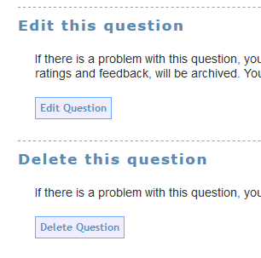

Important!!
Edit your question, DO NOT MAKE A NEW ONE
I see the edit history and all the comments and replies
Unless the first question is a disaster, don’t do multiple edits
This puts stress on your group members
Wait and then edit…
YES!

Slide 20
Workload
Talk to your group members – 1 hour?
Make ONE question – 1 hour?
Give FIVE comments – 30 min?
Revise your question – 30 min?

